Slide 1
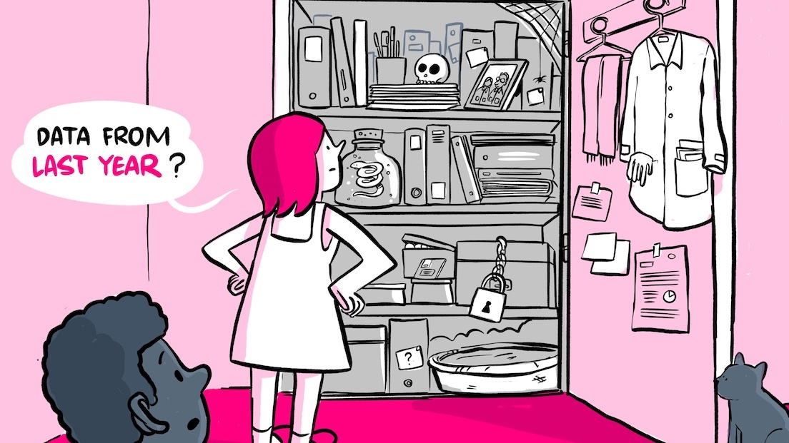


Research Data Management
Nami Sunami, n.sunami@tue.nl
orcid.org/0000-0001-5482-8370
DOI: 10.53962/gdkf-a36m
2024-11-18
This work is marked with CC0 1.0
Notes:
Image: Research Data Management: making it possible to retreive data from last year. The Turing Way project illustration by Scriberia. Original version on Zenodo. http://doi.org/10.5281/zenodo.3695300

Slide 2
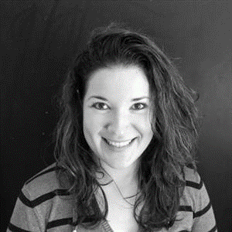

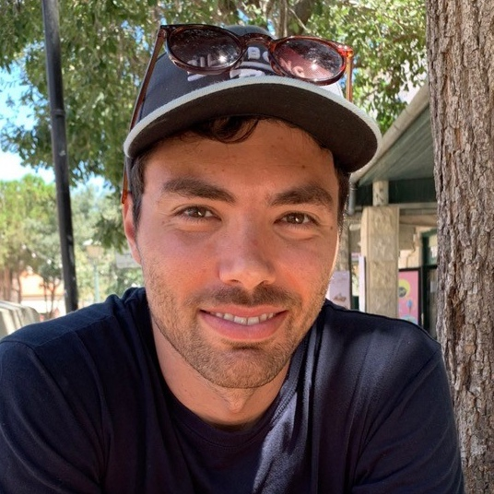
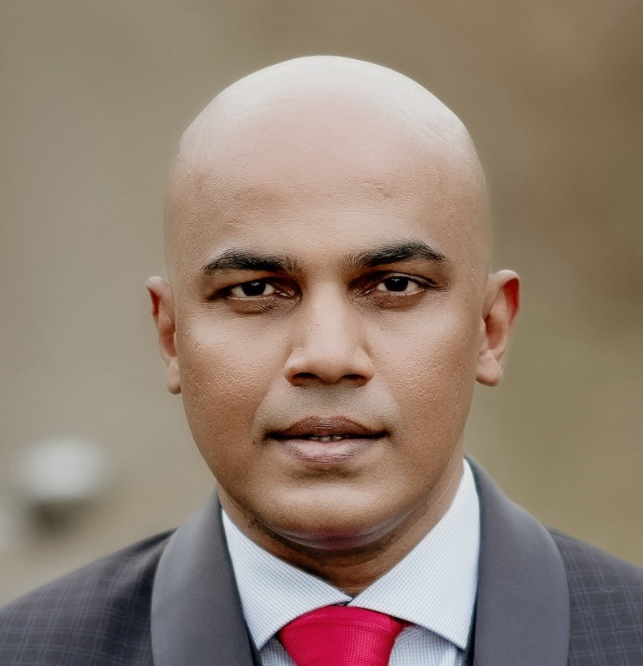
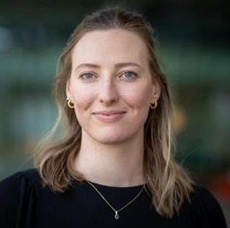
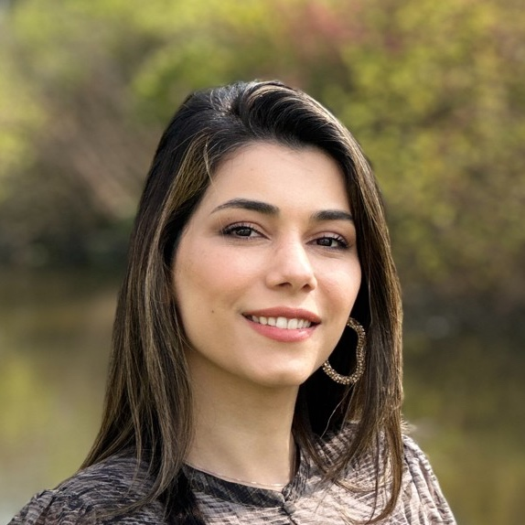
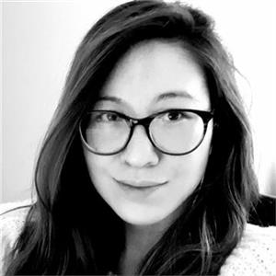

Data Stewards can help you
Liz Guzman-Ramirez
Coordinator
Angela Aleksovska
EE
Davide Nardi
M&CS
Jay Nair
IE&IS
rdmsupport@tue.nl
Lucia Forrová BE
Neda Norouzi
BME, ME
Mariana Oshima Menegon ID
Nami Sunami
CE&C, APSE

Slide 3
Research Data Management
Research data management concerns the way you collect, analyze, store, share, archive and publish research data, to satisfy the needs of current and future data users​.
Notes:
Research data management concerns the way you collect, analyze, store, share, archive and publish research data, to satisfy the needs of current and future data users​.

Slide 4





Research Data Abandonment
Paper
Data never to be looked at again
Create Data
Consume Data
Data loss & research waste
Notes:
Traditionally, we thought research data as something to be consumed, with a dead end

Slide 5




Research Data Management
Plan
Share & Reuse
Collect
Process & Analyze
Archive
Adopted from RDMkit: https://rdmkit.elixir-europe.org/data_life_cycle
Notes:
Research data management concerns the way you collect, analyze, store, share, archive and publish research data, to satisfy the needs of current and future data users​.

Slide 6
Why do RDM?

Slide 7




Policy, regulations, requirements
Code of Conduct for Research Integrity
Funder Requirements
GDPR
Code of Conduct for Research Integrity: nwo.nl/en/netherlands-code-conduct-research-integrity
NWO Grant Rules: nwo.nl/en/nwo-grant-rules

Slide 8




Less likely to lose data
Benefit for you and the research community
Recognition
Fight against scientific fraud
More efficient & sustainable science
Code of Conduct for Research Integrity: nwo.nl/en/netherlands-code-conduct-research-integrity
NWO Grant Rules: nwo.nl/en/nwo-grant-rules

Slide 10
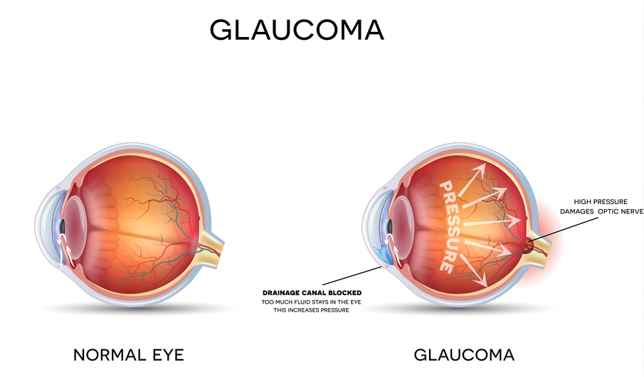
Example research project
Research Question:
“What causes variation in the rate of development of glaucoma in patients over the age of 50?”
Researcher collaborate with an industry partner & a hospital, exchanging datasets and code

Slide 11
Questions
What are research data management topics you need to consider in:
1) This Glaucoma example
2) Your own research project

Slide 12
What are research data management topics you need to consider?
Ethics
Privacy
Intellectual property
Agreements
Collection
Sharing
Storage
DMP
FAIR
Documentation
Folder structure
Filenames
Encryption
Anonymisation
Versioning
Metadata
Software
Archiving
Publishing
Repositories
Licensing

Slide 13
Research Data Lifecycle
Plan
Share & Reuse
Collect
Process & Analyze
Archive
Adopted from RDMkit: https://rdmkit.elixir-europe.org/data_life_cycle
Notes:
Research data management concerns the way you collect, analyze, store, share, archive and publish research data, to satisfy the needs of current and future data users​.

Slide 14
Plan

Slide 15


Topics to consider when planning
RDM Costs
Ethics
Privacy

Slide 16

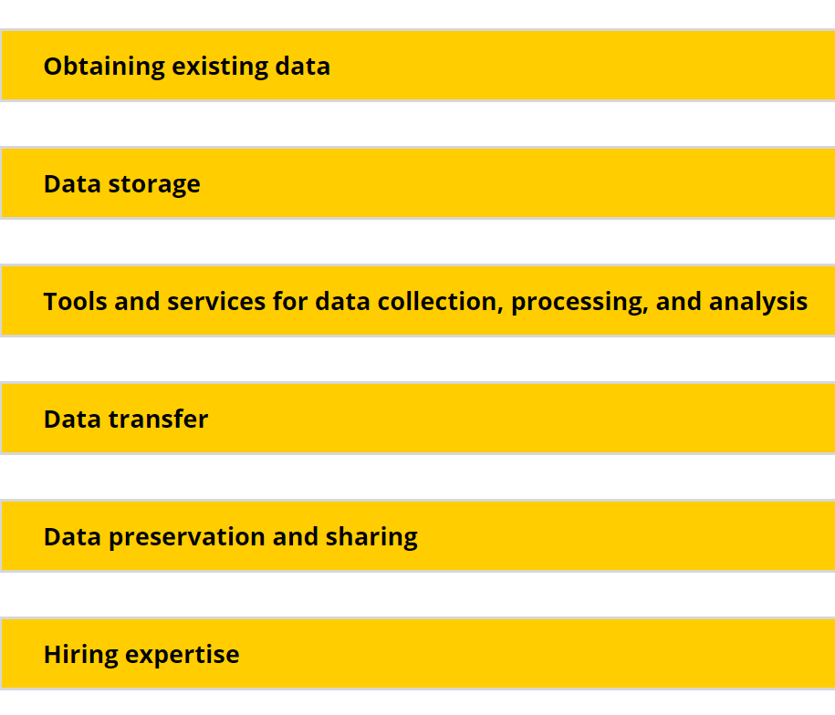
RDM costs
Plan
Good RDM planning means lower RDM costs later (both time and money)
Our advice is to reserve part of the funding for research data management-related costs

Slide 17
Ethical review process
Mandatory for all research or educational projects with human data
The purpose is to protect human participants and their data from harm
Low- and medium-risk
Assessed by departmental ERB.
2 working weeks to process
High-risk:
Assessed by the central ERB.
6 working weeks to process
Ethical Review | TU/e : https://tuenl.sharepoint.com/sites/intranet-ethical-review

Slide 18
Personal Data
Pla
Any information…
Any data that can be traced back to a living person
relating to an identified and identifiable…
natural person.
Privacy Handbook | UU: https://utrechtuniversity.github.io/dataprivacyhandbook/definitions.html

Slide 19
Special Categories of Personal Data
Racial or ethnic origin
Political opinions
Religious or philosophical beliefs
Further care is needed for special categories of personal data
Trade union membership
Genetic and biometric data to identify someone
Sex life or sexual orientation
Physical and mental health conditions

Slide 20
Best practices to protect privacy of participants
Minimize personal data collected
Data Processing Impact Assessment (DPIA) may be needed
Assess the privacy and security risks
Inform participants, obtain a consent
Anonymize or pseudonymize personal data

Slide 21
Ethics application process
Complete ERB form and consent form. A data steward can help you (rdmsupport@tue.nl)
Email the documents to the ERB ethics@tue.nl
New ERB process is being piloted at Research Cockpit. Contact your Data Steward.
Ethical Review Board | TU/e Intranet: https://tuenl.sharepoint.com/sites/intranet-ethical-review

Slide 22
If you are getting data from an external party, you may need an agreement
E.g., data sharing agreement
Agreements | TU/e: https://tuenl.sharepoint.com/sites/intranet-privacy-security/SitePages/agreements.aspx

Slide 23
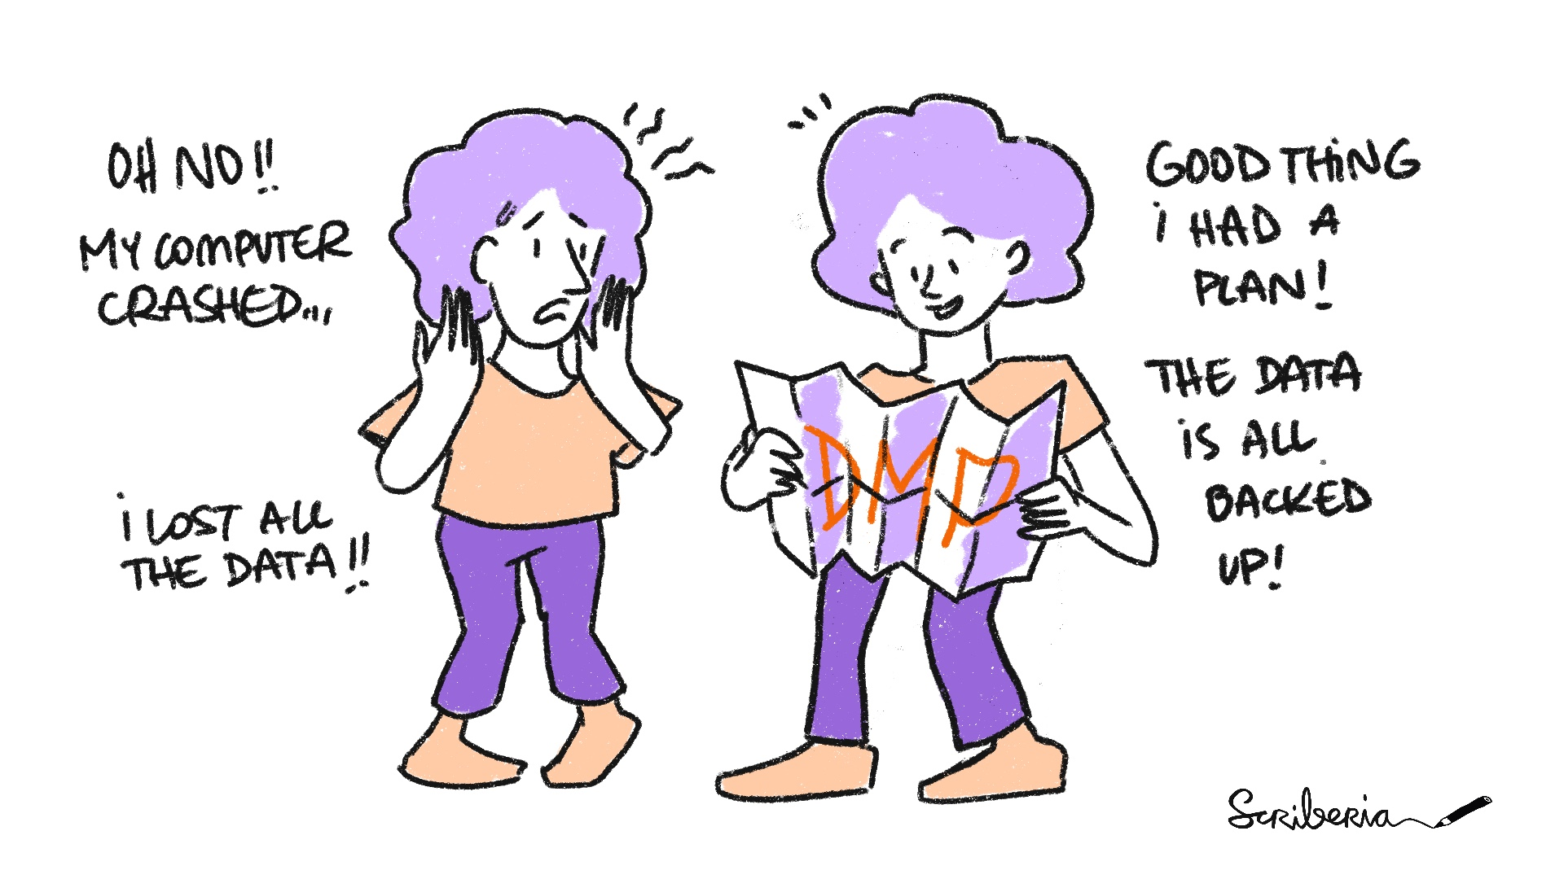
Data management plan
What type of data you will collect, and how much
How you will address privacy and intellectual property challenges
How you will archive and publish your data
How you are going to achieve FAIR principles
NWO and European Commission require a DMP
UU | Cost of Data management: uu.nl/en/research/research-data-management/guides/costs-of-data-management
NWO DMP: nwo.nl/en/research-data-management

Slide 24
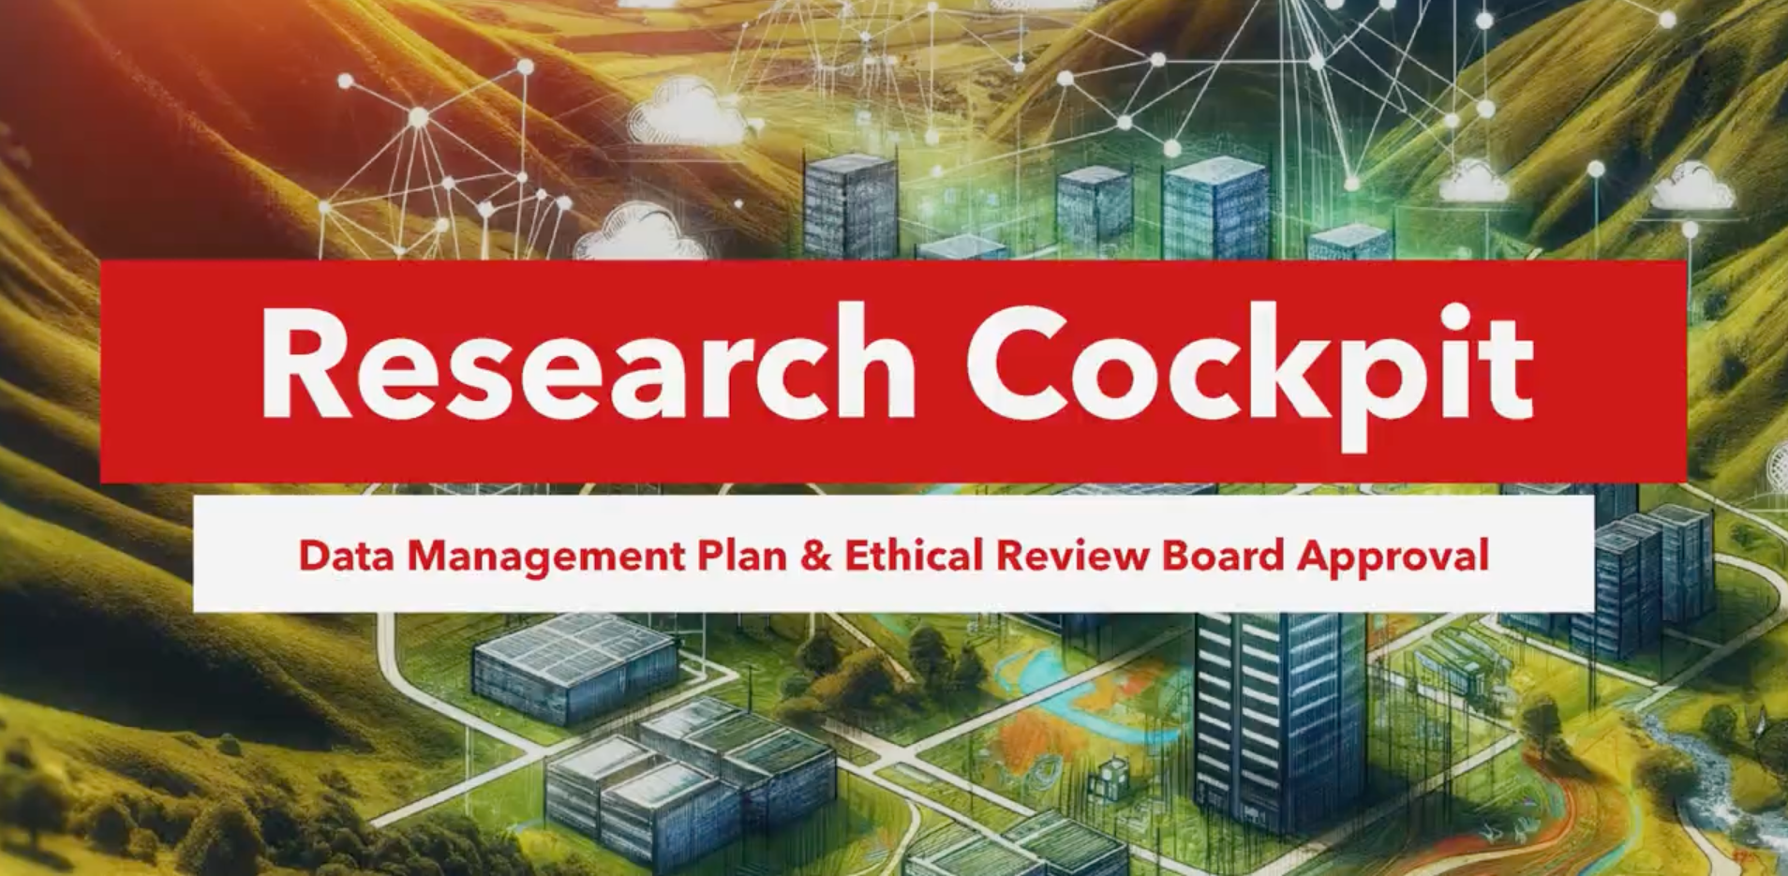
Create your Data Management Plan on Research Cockpit
https://tue.atlassian.net/helpcenter/research/

Slide 26
Planning may take time, but the effort will pay off later to make your data Open & FAIR

Slide 27
What do ”Open” & “FAIR” mean?

Slide 28
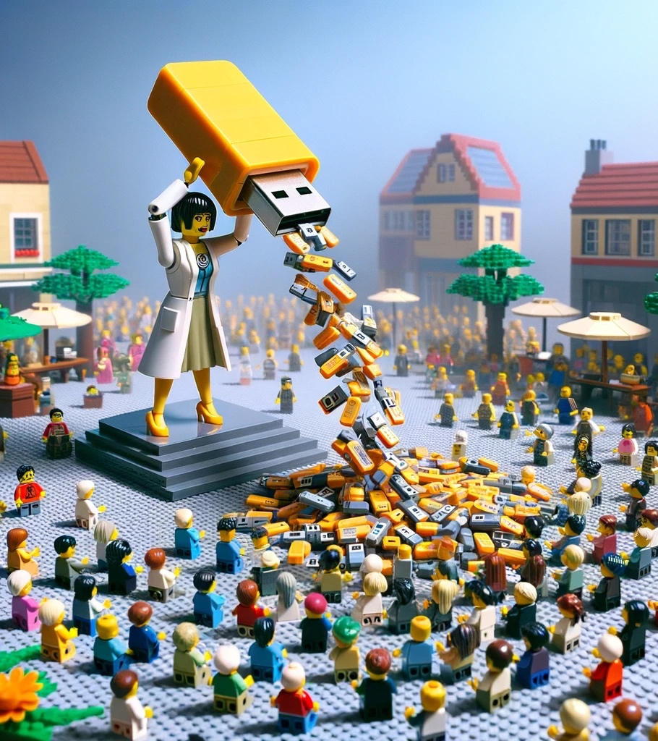
Open data is data anyone can freely access, use, modify, and share for any purpose
Notes:
We can have a visual of Open Data being on one end of a continuum, before the FAIR data
(Start with FAIR, and if there's no restriction, make your data Open Data)

Slide 29
Not all data can be shared freely
FAIR Data
Notes:
Still, we can tell what’s inside: just like a canned tomato soup -> that’s why we have FAIR

Slide 30
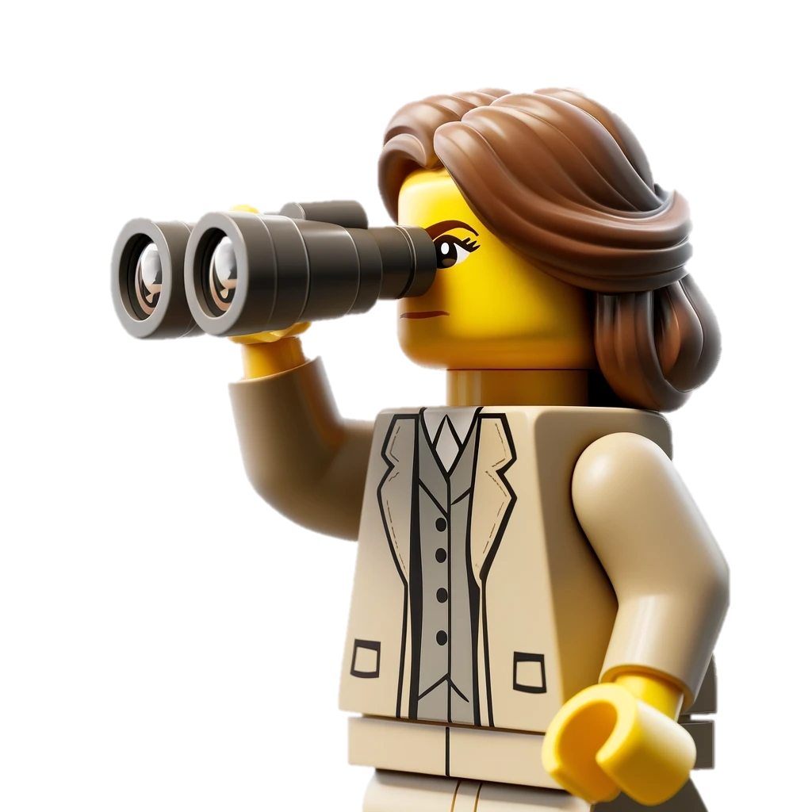
FAIR Data is data that satisfies FAIR Principles
Findable

Slide 31

FAIR Data is data that satisfies FAIR Principles
Findable
Accessible

Slide 32
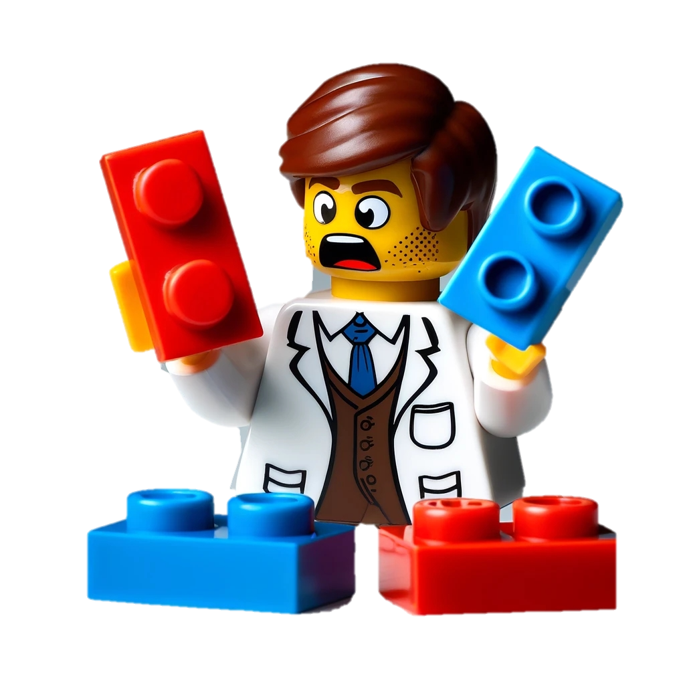
FAIR Data is data that satisfies FAIR Principles
Findable
Accessible
Interoperable

Slide 33
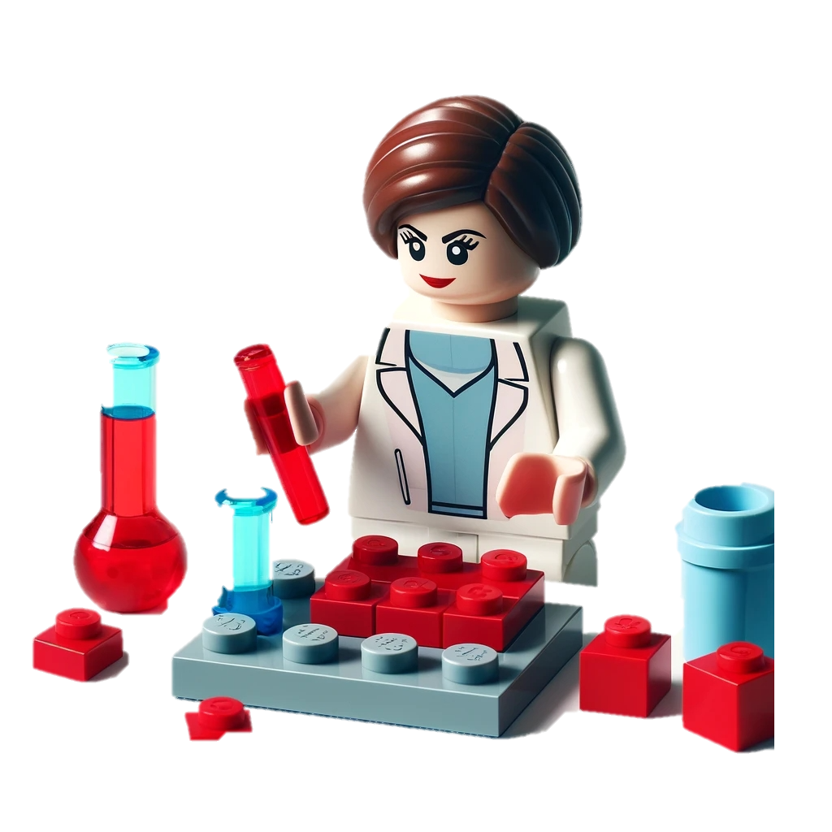
FAIR Data is data that satisfies FAIR Principles
Findable
Accessible
Interoperable
Reusable

Slide 34
Findable
Accessible
Interoperable
Reusable
?
Open Data
Notes:
Findable and accessible can be covered by being open, but not other two

Slide 35
Open ≠ FAIR
Notes:
Open doesn’t mean FAIR

Slide 36
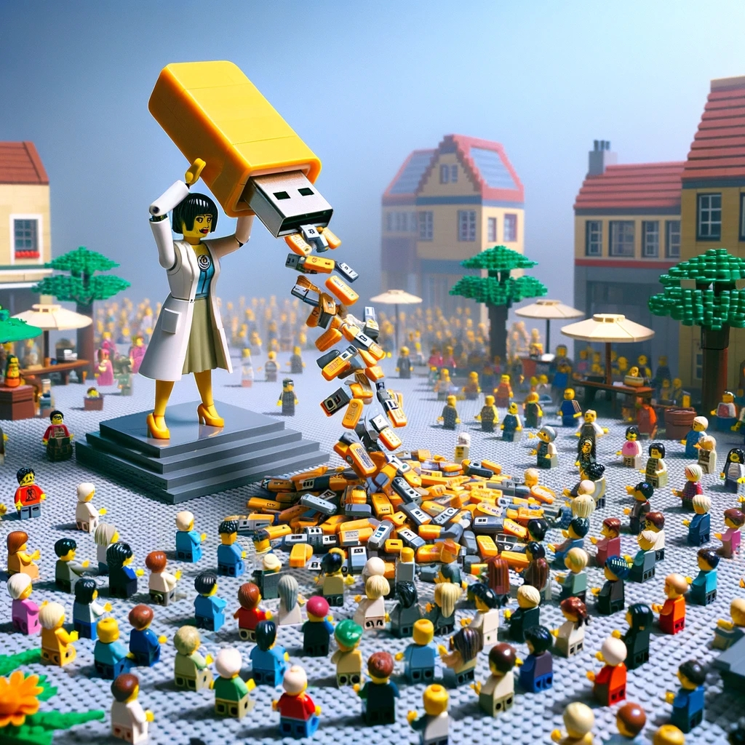

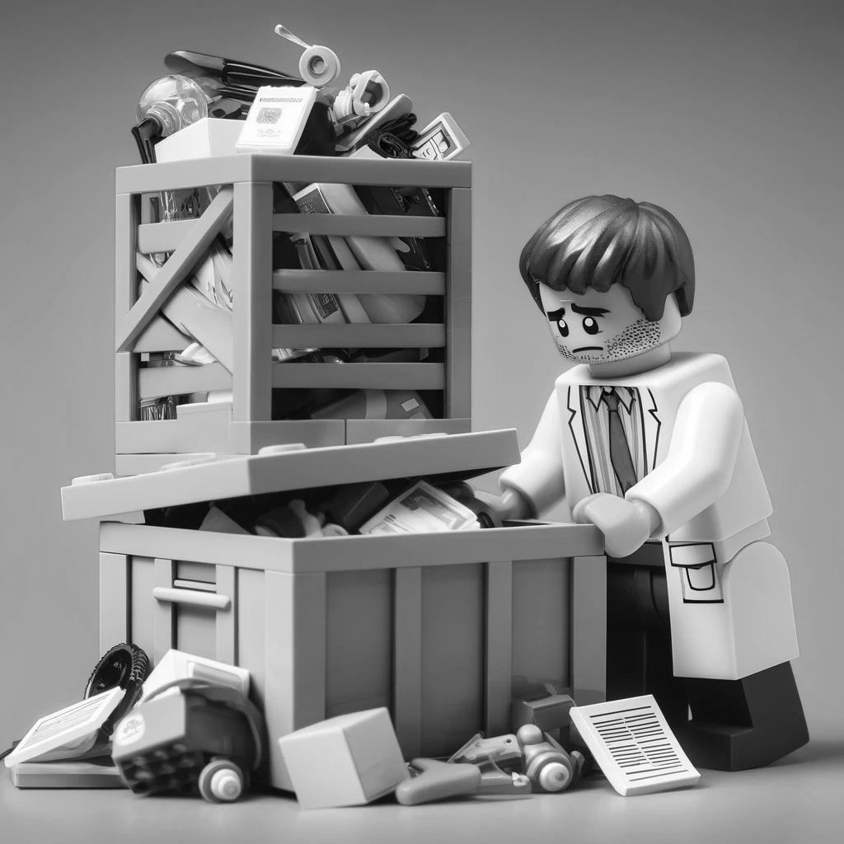

FAIR & Open
Yes
Open
No
No
Yes
FAIR
Notes:
Open data can be not FAIR. At the same time, FAIR data can be closed, not open.

Slide 38

Collect

Slide 39
Set your folder structure
Document the rationale on README
.
├── README.md
├── metadata.json
├── data/
│ ├── raw
│ └── processed
├── code/
├── output/
└── documentation/
├── methods
├── lab_notebooks
└── administration

Slide 40
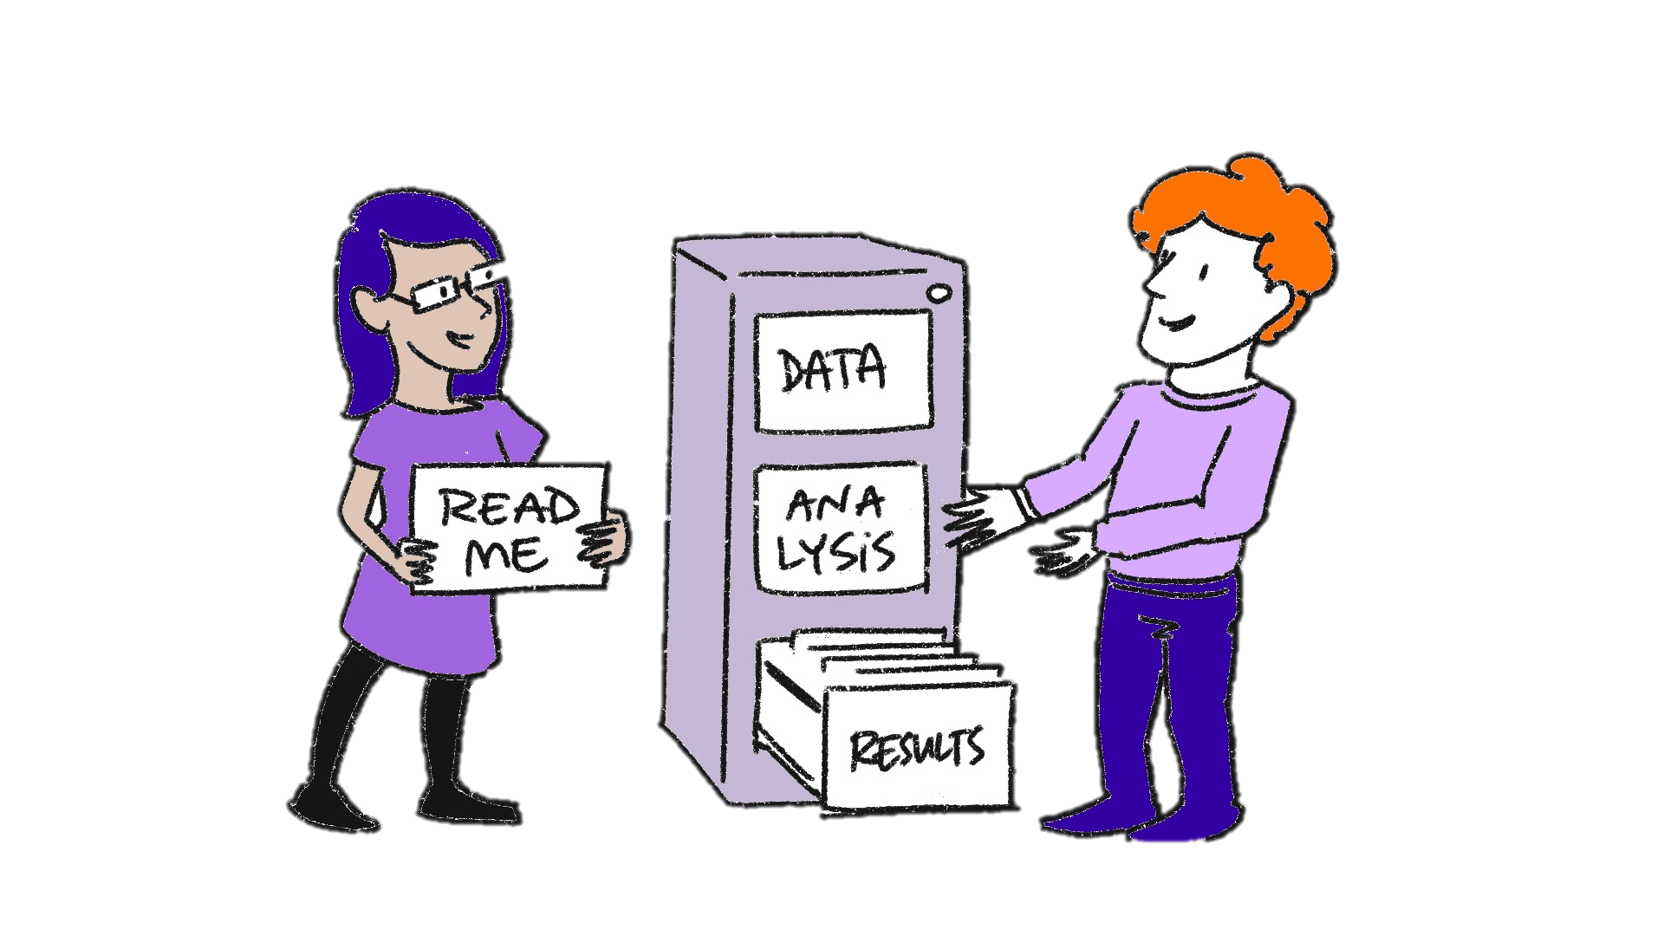
A README file makes your data human-friendly
A README file is a human-readable text file document that explains the project.
No one can read your mind—not even you in the future.
Illustration about managing files in a repository. The Turing Way project illustration by Scriberia. Used under a CC-BY 4.0 licence. DOI: 10.5281/zenodo.3332807
Make a README: makeareadme.com/
Guide to writing “readme” style metadata | Cornell: data.research.cornell.edu/data-management/sharing/readme/

Slide 41
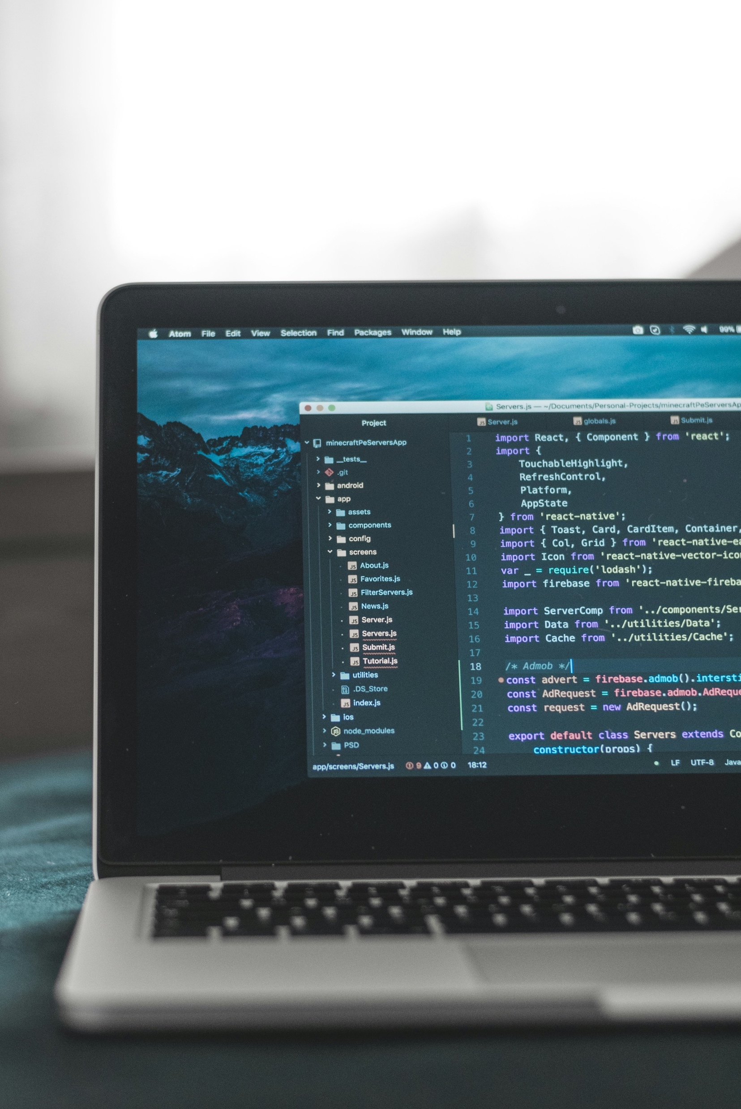
A metadata file makes your data machine-readable
On 4TU.ResearchData or Zenodo, you can start a dataset to prepare and download a metadata file, even without data.
You can manually create metadata file using DataCite Metadata Generator
Photo by AltumCode on Unsplash
DataCite Metadata Generator: dhvlab.gwi.uni-muenchen.de/datacite-generator/

Slide 42
Name files meaningfully, distinctly, and consistently—and document it
No special characters. Whitespaces are discouraged.
Case style: Do you want a camelCase, PascalCase, snake_case, or kebab-case?
ISO date format is good to use: “2024-07-03”
Turing Way: https://book.the-turing-way.org/project-design/filenaming.html

Slide 43
Store your data in a secured space with backups, where two or more people retain access.
PAR Solution Searcher | Storage: https://research-it.pages.tue.nl/solution-searcher/category-storage.html

Slide 44
Notes:
Now you collected data.
How will you process and analyze?

Slide 45
Storage options at TU/e

Slide 46
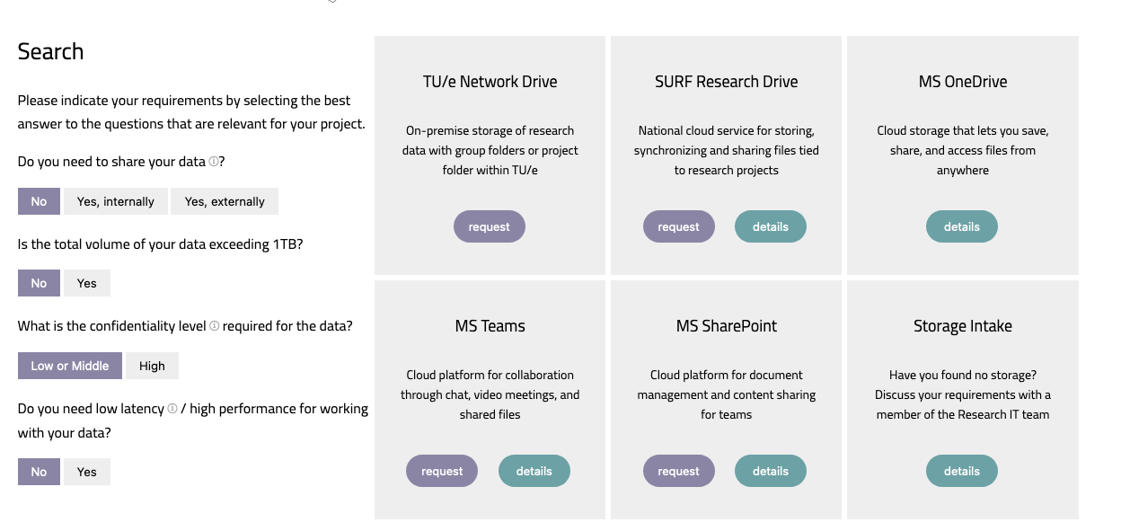
Storage Finder at Solution Searcher
https://openpar.pages.tue.nl/solution-searcher/category-storage.html

Slide 47


Personal/ Sensitive Data
Collaboration
TU/e Network Drive
TU/e only
SURF Research Drive
Teams/SharePoint (up to 2TB)
OneDrive (up to 1TB)
File/folder-based sharing only

Slide 48

You can encrypt your data using Cryptomator
You can do client-side encryption to store your data in password-protected Vaults
Cryptomator Hub | Resarch Cockpit : https://tue.atlassian.net/helpcenter/research/

Slide 49

Only sending data one-time? Use SURF File Sender
Remember to turn on encryption
SURFfilesender: https://filesender.surf.nl/

Slide 51
Storage for the Glaucoma example
Where would you store the glaucoma data at TU/e?
A) Dropbox
B) OneDrive
C) ResearchDrive
D) Network drive

Slide 52
Process & Analyze

Slide 53
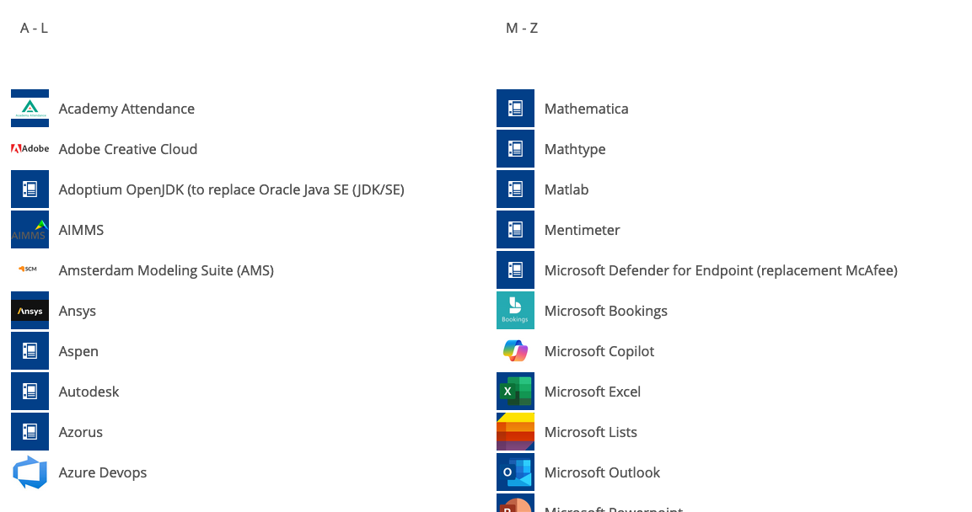
Find TU/e Tools on Topdesk
Overview of software available at TU/e: TU/e Software | Topdesk

Slide 54



Use open-source tools, whenever possible.
Python
JASP
R
Jamovi

Slide 55
If the original dataset is in a proprietary format, convert it to an open file format.

Slide 56
Questions
Do you need to use proprietary tools?
Any opportunities for using open tools?

Slide 57
Archive

Slide 58
Archiving data means keeping data to demonstrate the integrity of research
Typically, each publication requires an archival package
Preserving Data |UU: uu.nl/en/research/research-data-management/guides/after-research/preserving-data

Slide 59
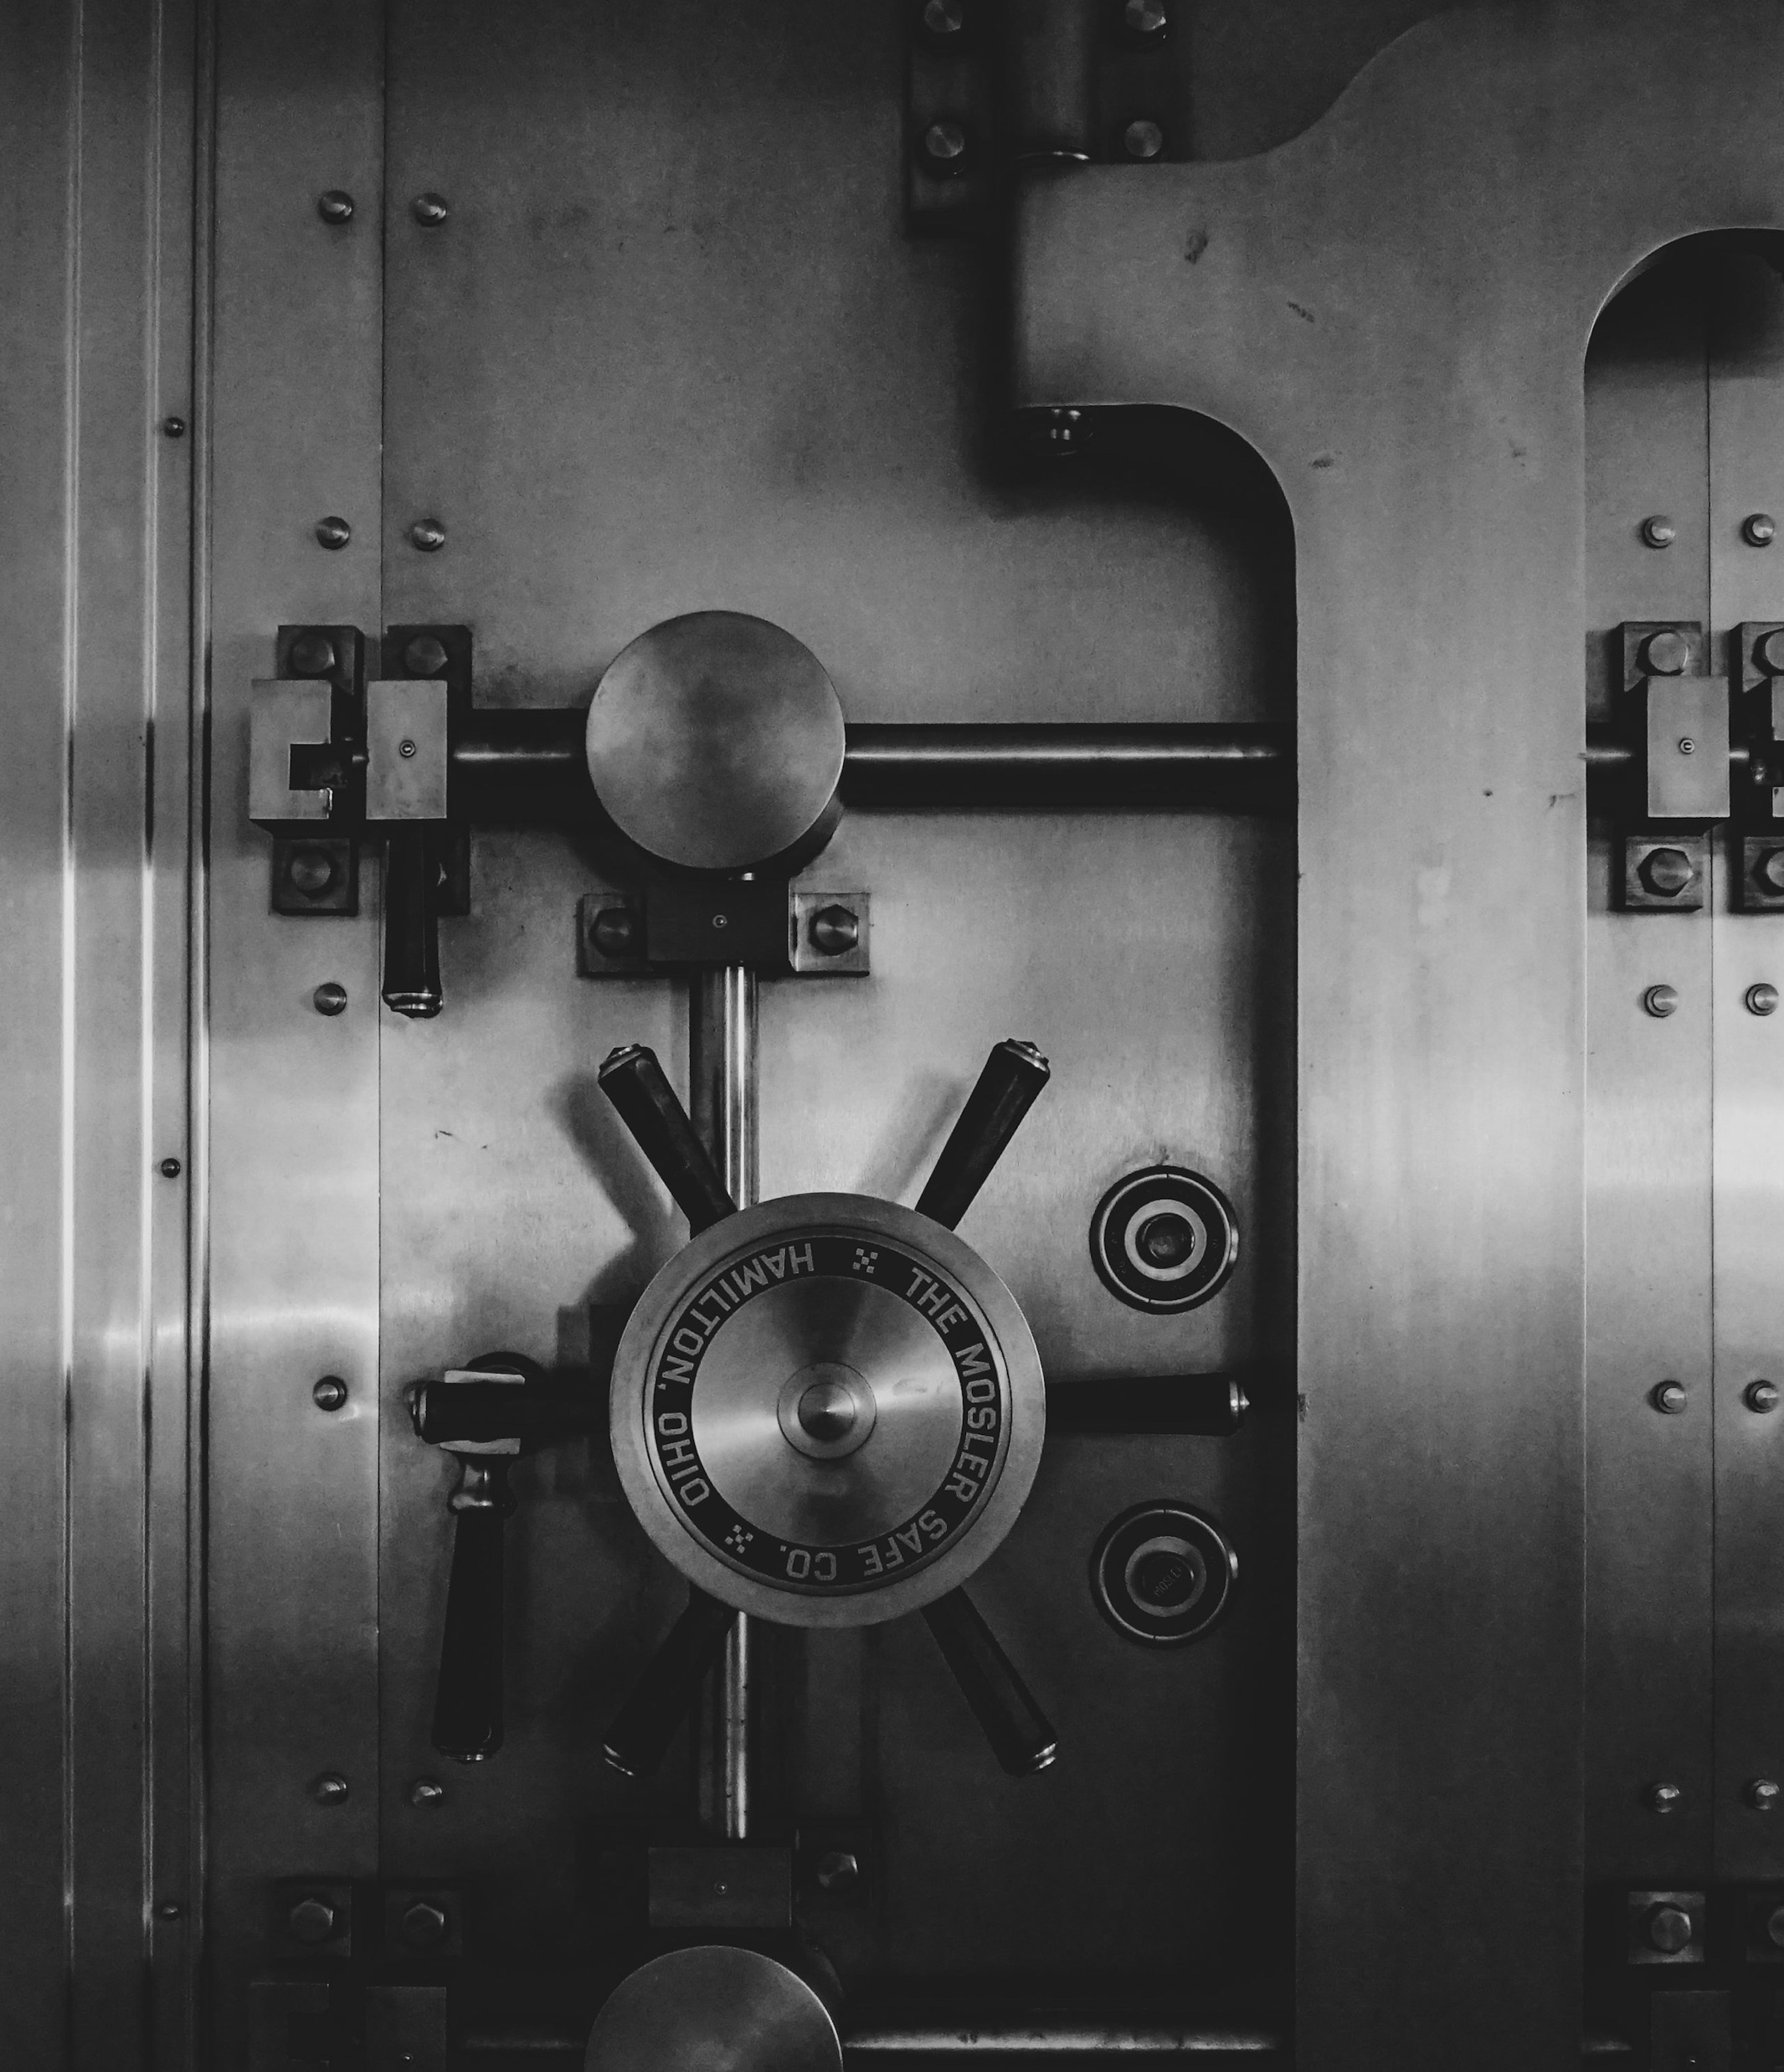
Access to archival package is limited
Accessed only when it’s need (for example, an integrity audit)
Usually stored in “colder storage” (cheaper storage but expensive transfers)
Photo by Jason Dent on Unsplash

Slide 61
Share & Reuse

Slide 62
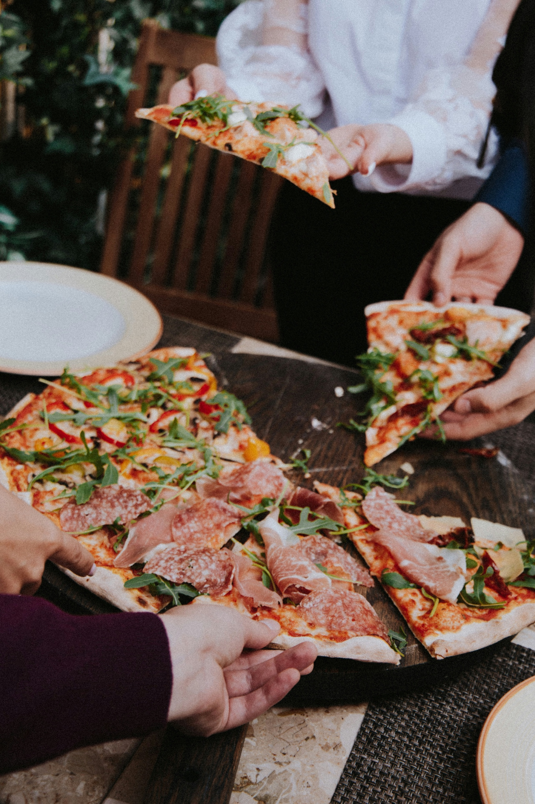
Creating a publication data package to share your data
The goal is to share data with others and future data users.
Anyone can access a publication package by default

Slide 63




Publication Package
Archival Package
To share
To demonstrate integrity
Main Goal
Public
Restricted
Access
By default

Slide 64
You can deposit data in a data repository & connect your publication.
Your discipline may have specialized data repositories. Use re3data.org to find out.
You can use generic repositories, such as 4TU.ResearchData & Zenodo.

Slide 65


Remember to assign an open license when depositing your data.
Data, documentation, non-code materials
Code
CC BY 4.0
MIT

Slide 66
Share your data as openly as possible as closed as necessary
Privacy, intellectual property, or collaboration agreements may pose challenge
FAIR Data Management in Horizon 2020: ec.europa.eu/research/participants/data/ref/h2020/grants_manual/hi/oa_pilot/h2020-hi-oa-data-mgt_en.pdf

Slide 67
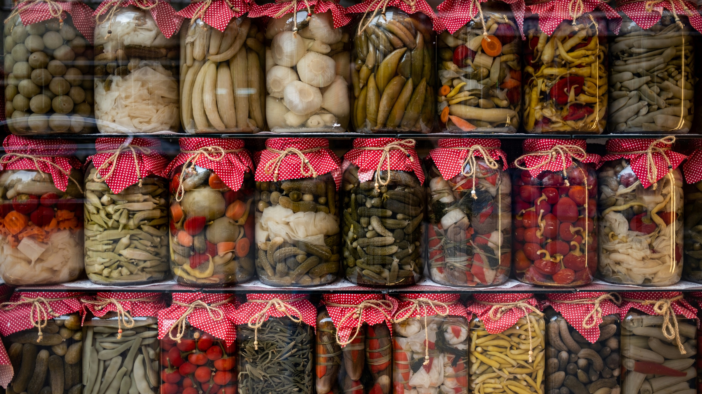
You might use your shared data in the future
Photo by Mehmet Uzut on Unsplash

Slide 68
Questions
What would be your challenges for sharing and re-using data?

Slide 69
Thank you
More info on RDM
Contact Data Steward
Data Stewards | Intranet
TU/e Research Data Management
rdmsupport@tue.nl
Search Storage | Storage Searcher
Create a DMP/ ERB
Research Cockpit

Slide 70
Icons in this slide deck are from Lucide, open-source icon library (https://lucide.dev/icons/rainbow)
Image are from:
Unsplash: https://unsplash.com/
Turing Way: https://book.the-turing-way.org

